Slide 1

GRAPH THEORY AND ITS APPLICATIONS
Dr. Arti Arya
Department of Computer Science & Engineering

Slide 2

GRAPH THEORY AND ITS APPLICATIONS
INTRODUCTION
Dr. Arti Arya
Department of Computer Science & Engineering

Slide 3
Graph Theory and its Applications Disclaimer
The slides are prepared by Dr. Surabhi Narayan and a lot of inputs are added by Dr. Arti Arya. The sources of the information other than text book is mentioned wherever used.

Slide 4
Graph Theory and its Applications Syllabus
Unit 1: Introduction, paths, cuts and planar Graphs
Introduction – Review of Representation and Traversals, Walks, Paths, Circuits Euler graphs Hamiltonian paths and circuits – Directed graphs, Digraphs and binary relations, Trees – Properties of trees, Rooted and binary trees, spanning trees, cut sets – Properties of cut set – All cut sets – Fundamental circuits and cut sets – Connectivity and Separability – Network flows, Isomorphism– Combinational and geometric graphs, Planar graphs –Different representation of a planar graph,
14 Hours
Unit 2: Graph Coloring, Graph Applications
Chromatic number – Chromatic partitioning – Chromatic polynomial, Matching, Covering, Four Colour problem, Register Allocation using graph coloring. Minimum Spanning Trees, Shortest Path Problem, Articulation Points, Network Flow Algorithms, Chinese Postman Problem, Time Table Problem, Strongly Connected Components
14 Hours

Slide 5

Graph Theory and its Applications Syllabus
Unit 3: Graph Databases and Graphs in Social Networks
Graph Database: RDBMS vs Graph Database, Neo4j Basics, Neo4j Graph Data Model, Nodes, Properties, Relationships, Labels, Neo4j CQL Commands and Functions. Introduction to Graphs in Social Networks:Graphs in Social Networks: Centrality measures: Degree, Betweenness, Closeness, Eigen vector, Katz and PageRank Centrality, Measures of cohesiveness: Degree distribution, Diameters, Transitivity and Reciprocity, Clustering coefficient, Groups and substructures: top-down view – weak and strong component, in-component, out-component, giant component.
14 Hours
Unit 4: Graphs in Social Networks and social graph dynamics
Bottom-up view: clique, N-clique, N-clan, N-club, N-core. Community detection: cluster vs. community, Overlapped
Communities by CPM, Girvan Newman algorithm, Louvain algorithm , Generative Models - Small World: Milgram’s small world experiment. Scale-free networks Random Graph Models, Barabasi and Albert's model, Watts-Strogatz small world model, Myopic Search. Dynamics on Graph : Herd behaviour, Diffusion-Diffusion of innovation, Bass model of diffusion – epidemic modelling, Cascades and Contagions, Percolation and Robustness of Networks, Effects of communities and centralities on diffusion
14 Hours

Slide 6
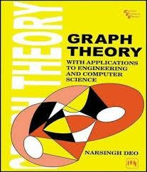
Graph Theory and its Applications Text Book and Reference Books
Text Book:
1: “Graph Theory: With Application to Engineering and Computer Science”, Narsingh Deo, Prentice Hall of India, 2017.
2: “Graph Databases: New Opportunities for connected data”, 2nd Edition, Ian Robinson, Jim Webber, Emil Eifrem, Oreilly Publications, 2015.
3: “Networks, Crowds, and Markets: Reasoning about a Highly Connected
World”, David Easley, Jon Kleinberg, Cambridge University Press, 2010
4: “Social Media Mining”, Reza Zafarani, Mohammad Ali Abbasi, Huan Liu, Cambridge University Press, 2014
5: “Network Science”, Albert-Laszlo Barabasi, e-book
Reference Book(s) :
1: “Graph Theory”, F. HARARY, Addison-Wesley,1969.
2: “Graph Theory with Applications”, J A Bondy and U. S. R Murthy, Elsevier Science Publishing Co. ., Inc.
3: “Graph Representation Learning”, William L Hamilton, Morgan and
Claypool Publishers, 2020.

Slide 7
Graph Theory and its Applications Evaluation Policy
 | Details | Marks
1 | ISA 1 and ISA2 | 40
4 | Assignment 1 | 2
3 | Assignment 2 | 3
3 | Assignment 3 | 5
 | ISA + Other Components | 50
4 | ESA | 50

Slide 8
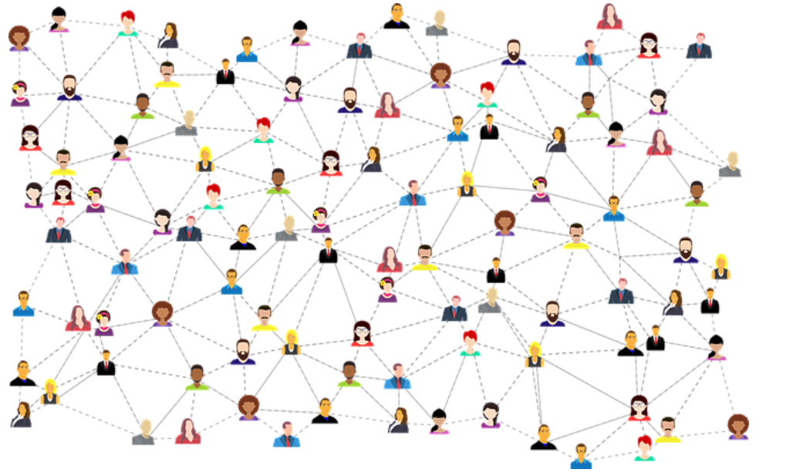

Graph Theory and its Applications Motivation
Social Network modeled as graph

Slide 9

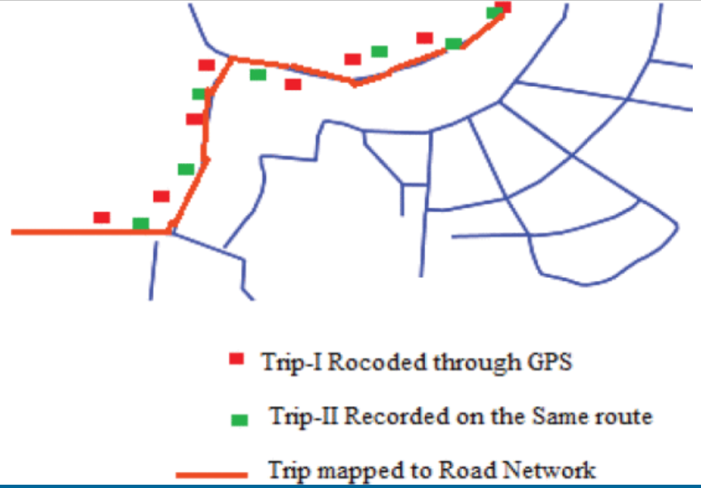
Graph Theory and its Applications Motivation
Think of Transportation Systems and Biological System Research?
(Road networks, railway networks, or flight routes)
Can be modeled as Graphs
https://ieeexplore.ieee.org/abstract/document/6514292/figures#figures

Slide 10
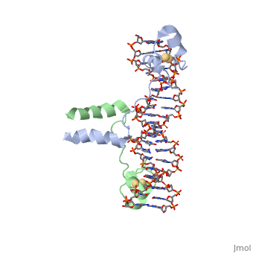
Graph Theory and its Applications Motivation
Think of Transportation Systems and Biological System Research?
(and now think of protein-protein interaction, gene regulatory networks)
Can be modeled as Graphs
https://proteopedia.org/cgi-bin/pubready?j=87941691426139&k=de7773d0f277bde4f63022df94c54960&pnam=DNA-protein_interactions

Slide 11
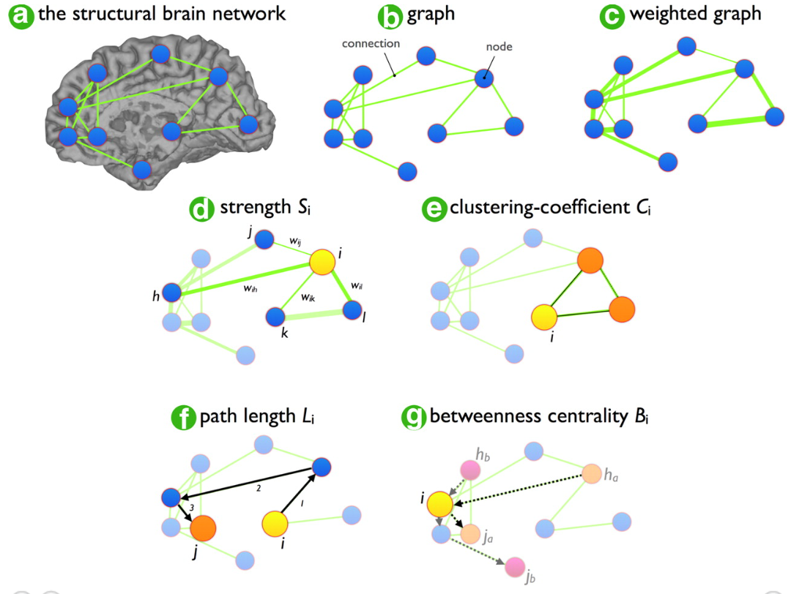
Graph Theory and its Applications Motivation
Product marketing and scheduling flights?
Finding cure for mental illness, computer chip design, architectural floor planning, fighting terror online?
Can be modeled as Graphs
https://www.jneurosci.org/content/30/47/15915

Slide 12
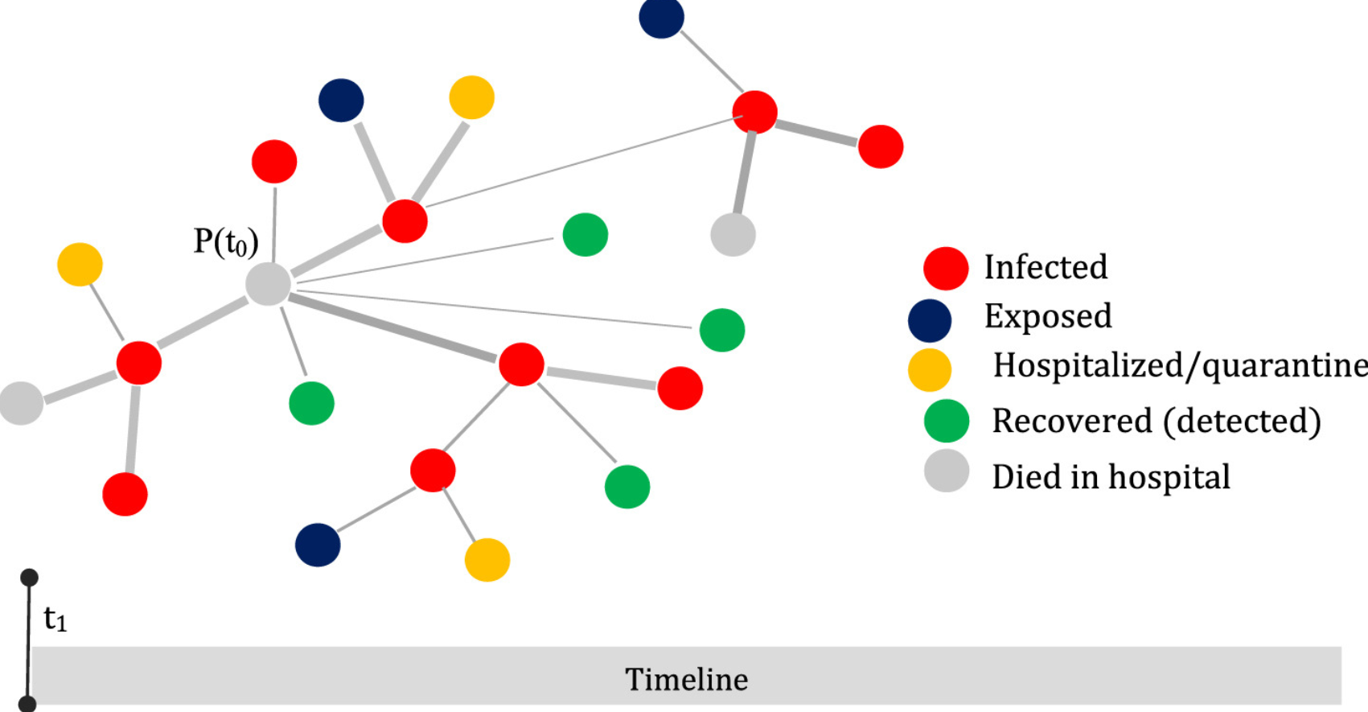
Graph Theory and its Applications Motivation
Fighting epidemics/ pandemic, e-commerce, designing voting schemes, job assignment, designing electrical networks, deciding on facility location, etc. etc. etc.
https://www.sciencedirect.com/science/article/pii/S2468042720301068
Can be modeled as Graphs

Slide 13
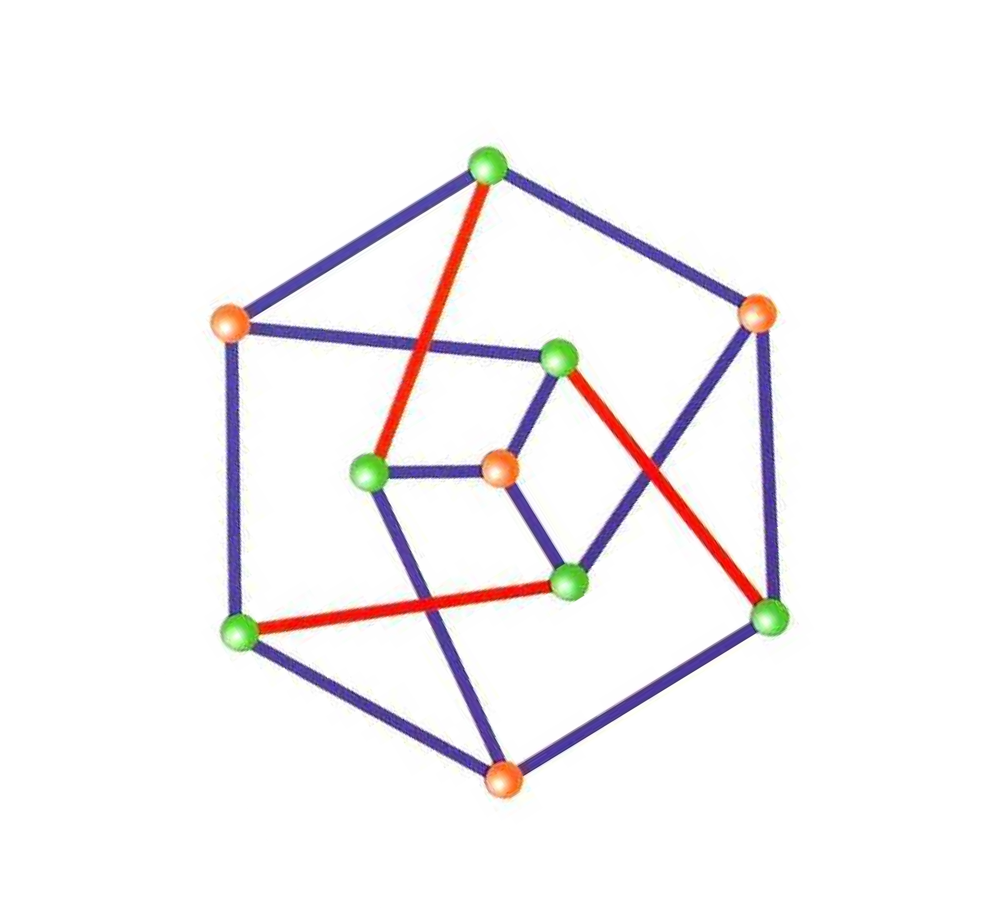

Graph Theory and its Applications Graph Theory
What is Graph Theory?
The mathematical theory of the properties and applications of graphs.
Used to understand and solve many of mathematical and path problems.
Graph theory is the study of graphs which are mathematical structures used to model pairwise relations between objects.

Slide 14
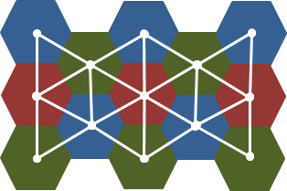
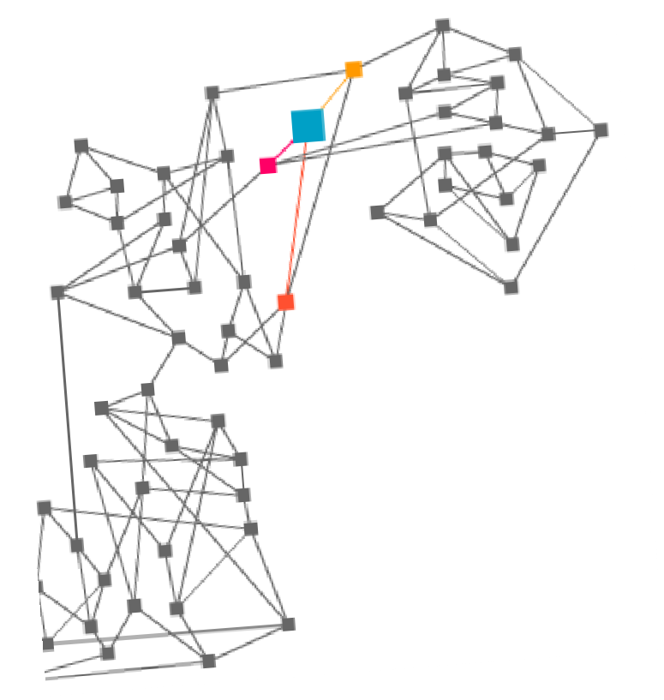
Graph Theory and its Applications Fields of Study
Other examples:
Electrical engg.
Biochemistry
Computer science
Physics
The cells of a GSM ( Global System of Mobile communication) mobile phone network
Music

Slide 15
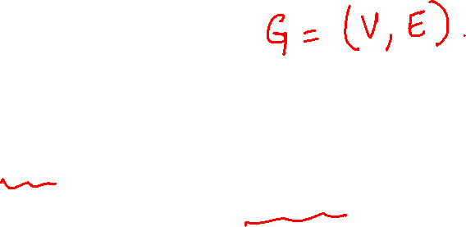
Graph Theory and its Applications Introduction
What is a graph?
A set of points and lines joining these points.
Formally: G=(V,E), V-vertices, E-edges

Slide 16
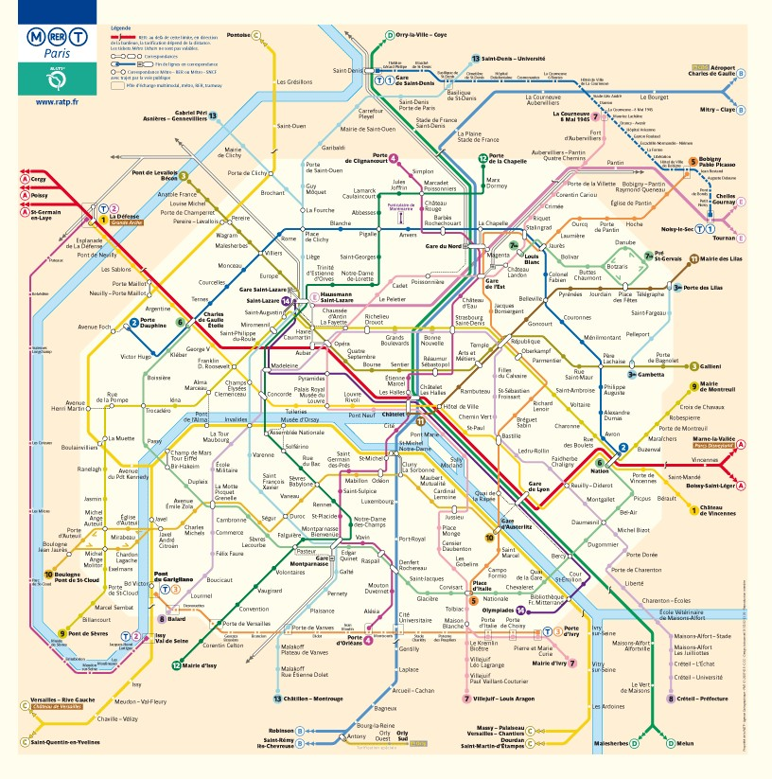
Graph Theory and its Applications Graphs as model
Networks: transportation, roadmaps, computer, electrical, etc.

Slide 17
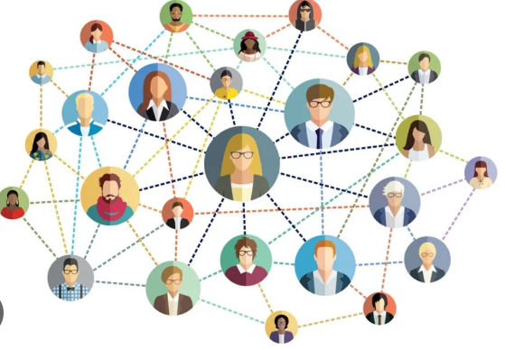
Graph Theory and its Applications Graphs as models
Personnel assignment problems: (assigning people to jobs, arranging weddings, finding appropriate roommates, etc.)
Social networks
Acquaintance Ship
Friendship Graph
Influence Graph Model
Collaboration Graph Model

Slide 18
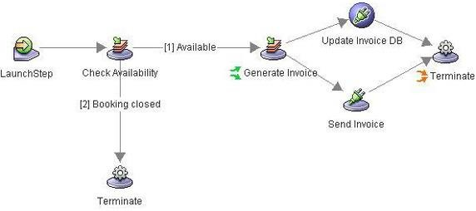
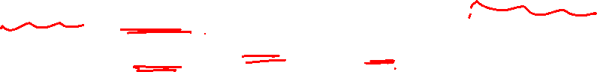
Graph Theory and its Applications Graphs as models
Workflow: A sequence of processes through which a piece of work passes from initiation to completion.
A graph can be represented as directed graph as well.

Slide 19
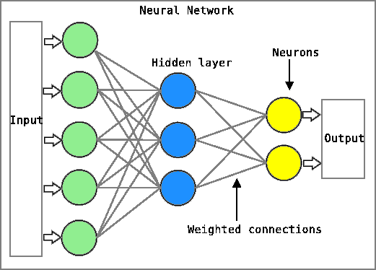
Graph Theory and its Applications
Graphs as models
Neural Networks: A series of algorithms that attempt to identify underlying relationships in a set of data by using a process that mimics the way the human brain operates.

Slide 20
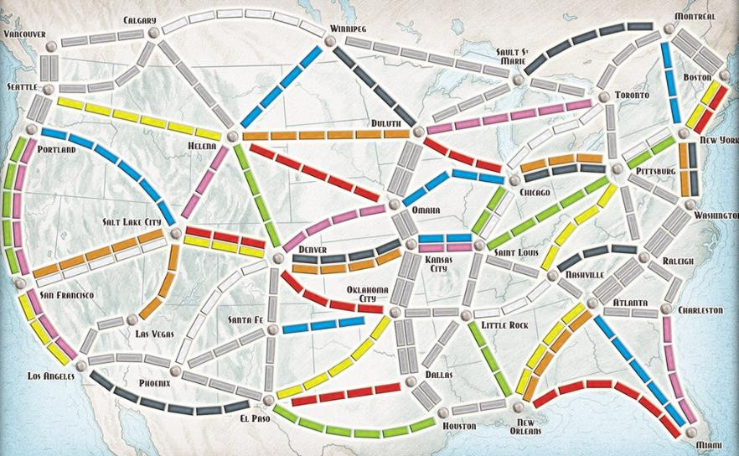
Graph Theory and its Applications
Graphs as models
Google Maps:

Slide 21

Graph Theory and its Applications
Graphs as models
Assignment Problem
workers
machines
w1
1
m1
3
1
1.5²
w2
m2
2
2
w3
m3
1.7
4
w4
m4
3
2
^{w5} m5
Find a minimum (maximum) cost assignment
of workers to machines

Slide 22
Graph Theory and its Applications Graphs as models
Connector problem
Design a railway network connecting a number of cities, with a
minimum possible construction cost.
Or electrical network, cable TV, gas, etc.
Connector Problem: Given a weighted graph,
find the MST

Slide 23

Graph Theory and its Applications
Graphs as models
Vehicle Routing
Need to transport n children from m bus stops across the city.
There are k buses, each bus j has capacity cj. Each km has a cost. (time).
Problem: Route the buses s.t. the total cost (or time) is minimized.
Difficult – intractable problem!
(Tractable Problem: a problem that is solvable by a polynomial-time algorithm. The upper bound is polynomial. Intractable Problem: a problem that cannot be solved by a polynomial-time algorithm.)

Slide 24

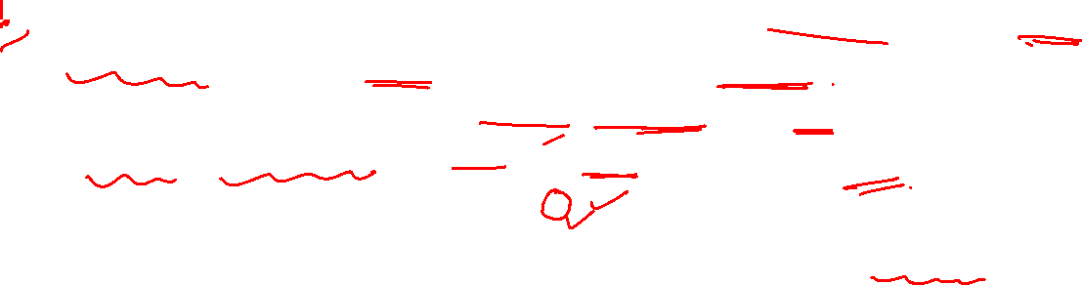
Graph Theory and its Applications Graphs as models
Chinese Postman Problem
It is the problem that the Chinese Postman faces: he wishes to travel along every road in a city in order to deliver letters, with the least possible distance.
The problem is how to find a shortest closed walk of the graph in which each edge is traversed at least once, rather than exactly once
PO
In graph theory, an Euler cycle in a connected, weighted graph is called the Chinese Postman problem.
https://personal.utdallas.edu/~dzdu/cs6363/Chinese.htm

Slide 25
Graph Theory and its Applications Graphs as models
Chinese Postman Problem
It is the problem that the Chinese Postman faces: he wishes to travel along every road in a city in order to deliver letters, with the least possible distance.
The problem is how to find a shortest closed walk of the graph in which each edge is traversed at least once, rather than exactly once.
PO
In graph theory, an Euler cycle in a connected, weighted graph is called the Chinese Postman problem.
Does the graph has an Euler Tour?

Slide 26

Graph Theory and its Applications Graphs as models
Chinese Postman Problem
A postman begins in the post office, has to traverse all the streets, and returns to the post office in a shortest possible distance.
Does a graph have an Euler tour?
PO
Tractable??…
It is fixed-parameter tractable when parameterized by both number of edges and arcs

Slide 27

Graph Theory and its Applications Graphs as models
House of Santa Claus: the house in the picture can be represented as a graph, where each vertex is a node. Draw the house by yourself fallowing this rules:
Draw the house in one line.
Must not lift your pencil while drawing.
Must not repeat a line.

Slide 28
Graph Theory and its Applications
Graphs as models
Chinese Postman Problem- another application Testing a computer program
V – states of a program
E – transitions between the states
Problem: Generate input data that forces the program to test all possible transitions.
Another Problem: Test all pairs of consecutive transitions… (how should we do that?)

Slide 29
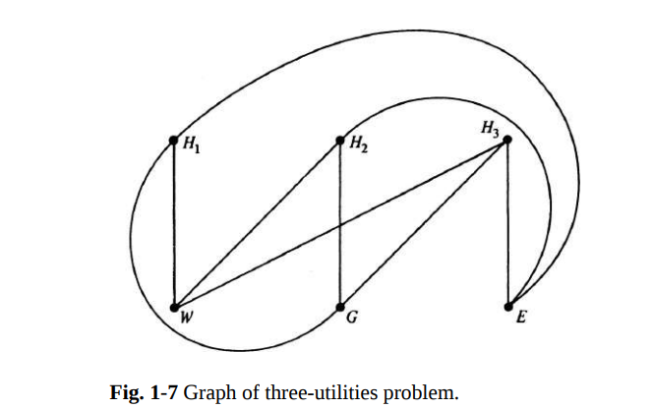
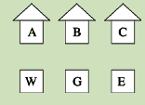
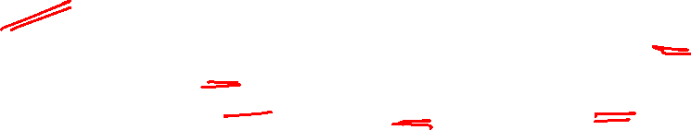
Graph Theory and its Applications
Graphs as models
Three Houses, Three Utilities: there are three utilities (three vertices) and three houses (three vertices), and the purpose of this problem is to draw a line from each house to each facility without the lines ever crossing.

Slide 30
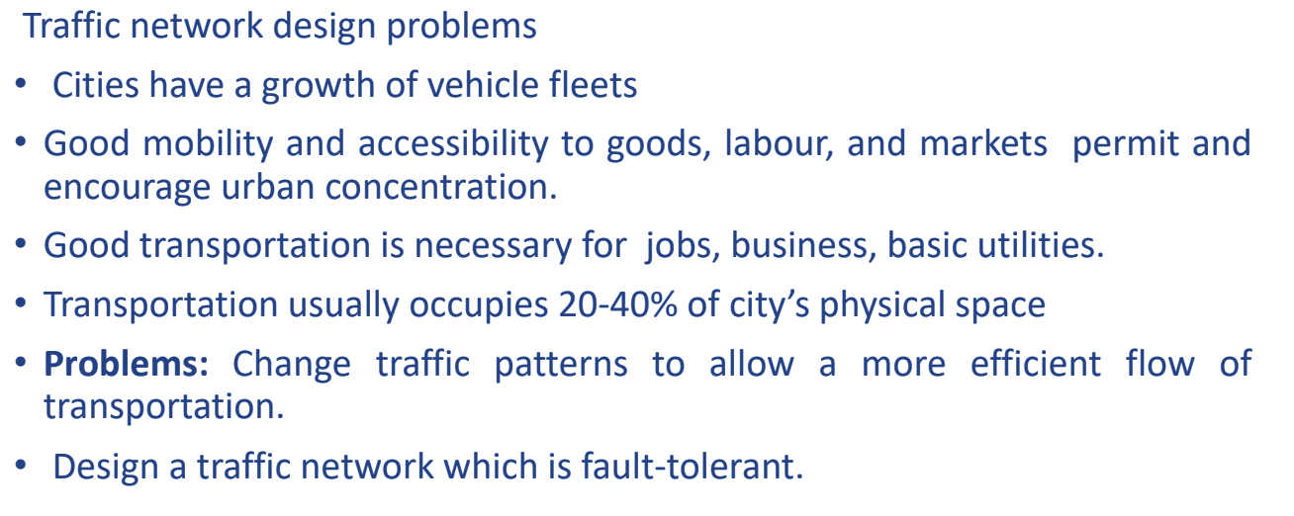
Graph Theory and its Applications Graphs as models

Slide 31
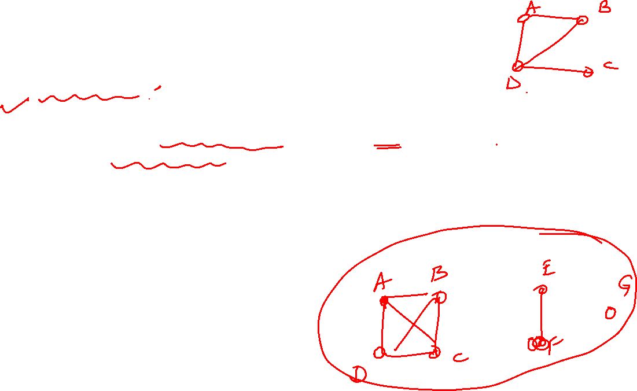
Graph Theory and its Applications Graphs as models
Traffic network design problems
Problem 1: Given an undirected graph, orient the edges so that the resultant graph is strongly connected (i.e. between any 2 vertices x,y there is a directed path from x to y).
Can be done iff the graph contains no cut edges.
Problem 2: Orient the graph, or add edges, s.t. even if two (or k)
edges ( or vertices) fail, it is still strongly connected.
Relates to the concept of connectivity of graphs.

Slide 32
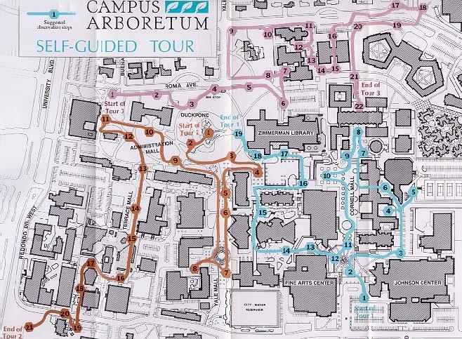
Graph Theory and its Applications Graphs as models
Facility location (A problem in OR)
Placing facilities that serve certain clients with certain
demands in a way that minimizes the total cost.
E.g., placing hospitals, police stations in a ,
warehouses that serve shops, placement of content
distribution servers on the Internet city, etc.
Problem is intractable

Slide 33
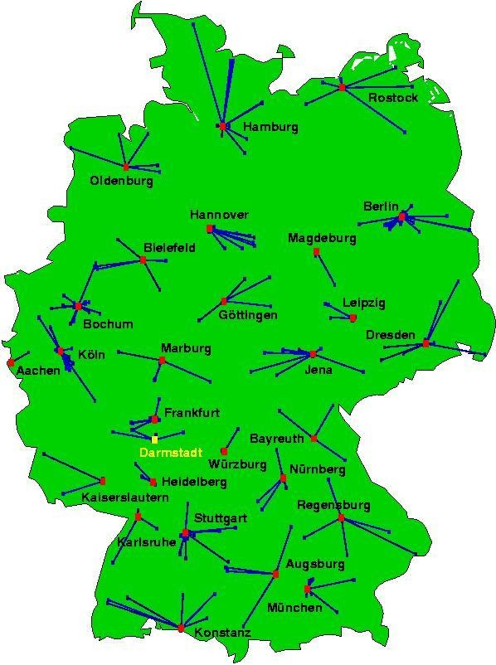
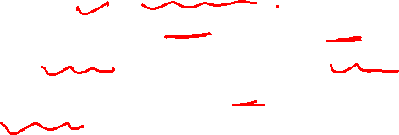
Graph Theory and its Applications Graphs as models
Facility location: k-median problem
Given a weighted graph, specified vertices called clients. Need to place facilities in k vertices in the graph which will serve the clients best possible. .
Minimize the distance of a client to each closest facility.
Facilities also have costs.

Slide 34
Graph Theory and its Applications Graphs as models
Dominating set problem
Given G=(V,E). Find a subset of vertices S s.t. every vertex is either in S or is
adjacent to at least one vertex in S.
Application:
Surveillance - put radar stations to keep an eye on strategic locations.
Chess – min no. of queens in a chess board so that all the pieces are covered.
Problem is intractable!

Slide 35
Graph Theory and its Applications Graphs as models
surveillance : Art Gallery
Vertex cover

Slide 36
Graph Theory and its Applications Graphs as models
Chemistry
H
O
N
H
H
O
N
C
H
H
H C
C
C
H
H
C
N
H
H
N
N
H
C
N
O
C3H7N2O2
H
H O
H
Graph isomorphism problem

Slide 37







Graph Theory and its Applications Graphs as models
Chemistry
G1=(V1,E1) and G2=(V2,E2) are isomorphic if there exists
a 1-1 mapping f: V1 -> V2
s.t. (i,j) is an edge in E1 iff (f(i),f(j)) is an edge in E2
E.g.
Determining whether 2 graphs are isomorphic is a difficult problem!

Slide 38
Graph Theory and its Applications Graphs as models
Biology
A new field has recently emerged called bioinformatics –
application of IT and CS to molecular biology.
DNA sequencing
Constructing phylogenetic (evolutionary) trees
Competition graphs.
Modeling ecological landscapes
Understanding the dynamics of disease propagation
Investigating the roles of genes and proteins,
Etc.

Slide 39
Graph Theory and its Applications Graphs as models
DNA sequencing
The building blocks of a DNA molecule are nucleotide bases— Adenine, Guanine, Cytosine, and Thymine (AGCT.) arranged in a sequence.
Length of sequence is order of 3x10**9
A special technology allows us to “see” fragments of length
500-1200 nucleotides.
How do we piece them together to find out the whole
sequence of the DNA?
Difference in DNA between 2 people is less than 0.1%.

Slide 40



Graph Theory and its Applications Graphs as models
DNA sequencing
Construct a directed graph where
V- fragments
E – (vi,vj) if end of fragment i coincides with beginning of fragment j.
Find an Euler trail
Is it unique?
Are all possible fragments there?
Possible errors?
CTGA
GACT
AAGA
CTCT
CTAA

Slide 41

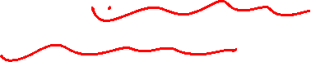
Graph Theory and its Applications Graphs as models
Models of the Spread and Control of Disease through Social Networks (slides from F. Roberts talk –DIMACS)
Diseases are spread through social networks.
“Contact tracing” is an important part of any strategy to combat outbreaks of infectious diseases, whether naturally occurring or resulting from bioterrorist attacks.

Slide 42



Graph Theory and its Applications
Graphs as models
Models of the Spread and Control of Disease through Social Networks (slides from F. Roberts talk –DIMACS)
Social Network = Graph Vertices = People Edges = contact
Let s_{i}(t) give the state of vertex i at time t. Simplified Model: Two states:
t=0
= susceptible, = infected (SI Model) Times are discrete: t = 0, 1, 2, …
More complex models: SI, SEI, SEIR, etc. S = susceptible, E = exposed,
I = infected, R = recovered (or removed)

Slide 43


Graph Theory and its Applications Graphs as models
Models of the Spread and Control of Disease through Social Networks (slides from F. Roberts talk –DIMACS)
Complications to Add to Model
k = 1, but you only get infected with a certain probability.
You are automatically cured after you are in the infected state for d time periods.
A public health authority has the ability to “vaccinate” a certain number of vertices, making them immune from infection.
t=0

Slide 44
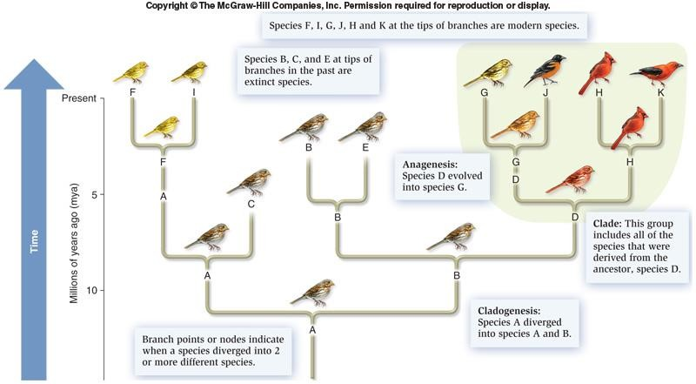
Graph Theory and its Applications Graphs as models
Biology – phylogenetic tree

Slide 45
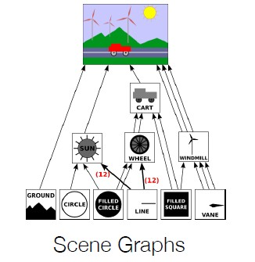
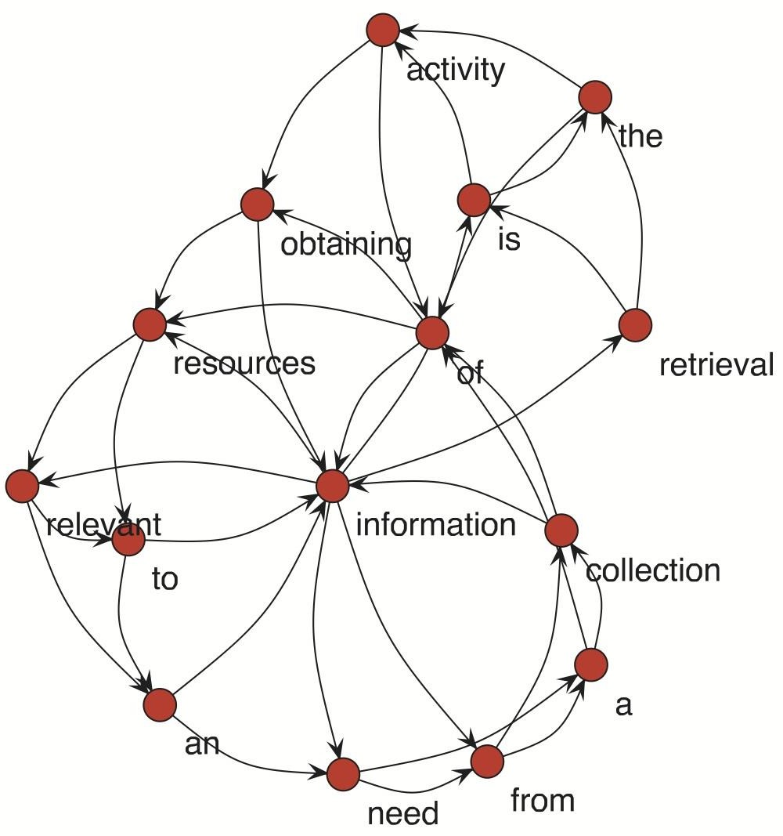
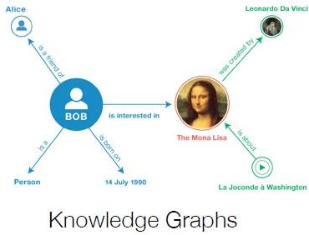
Graph Theory and its Applications Graphs as models
Graph of Words

Slide 46
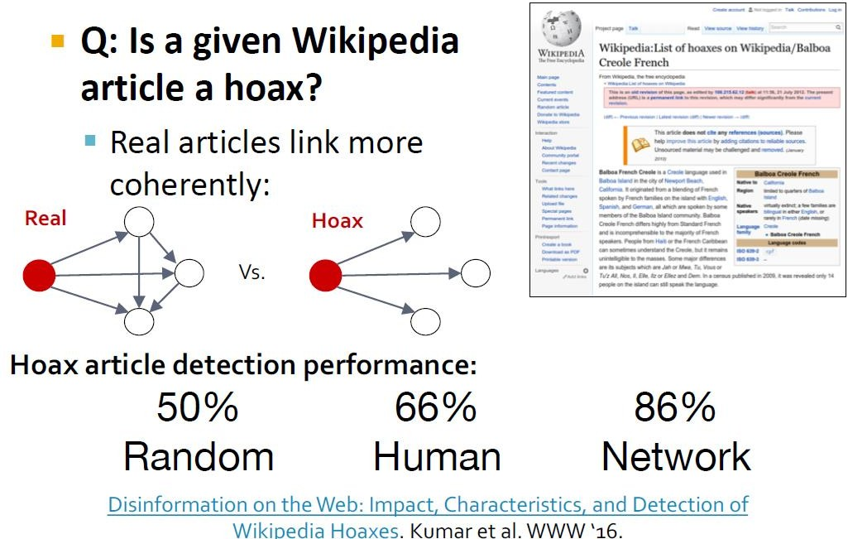
Graph Theory and its Applications Graphs as models

Slide 47
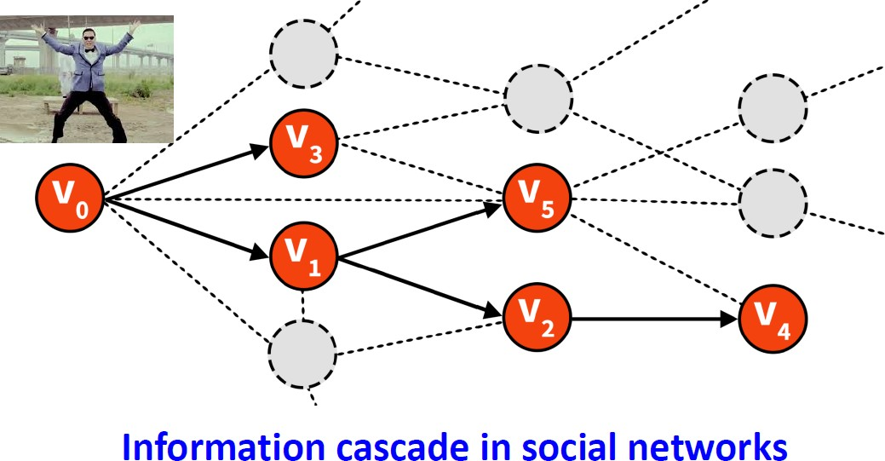
Graph Theory and its Applications Graphs as models
Predicting Virality

Slide 48
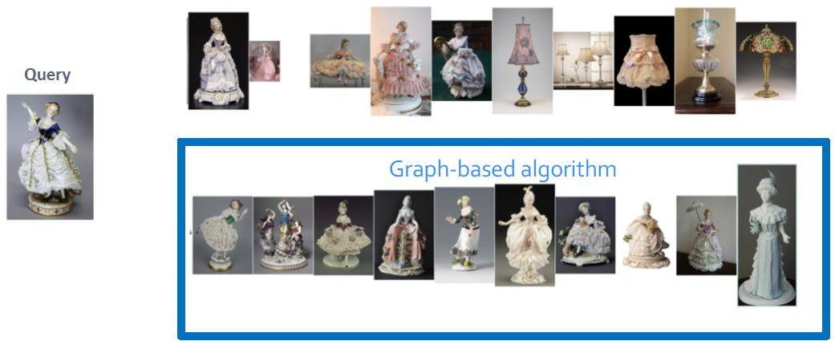
Graph Theory and its Applications Graphs as models
Recommendation Systems

Slide 49
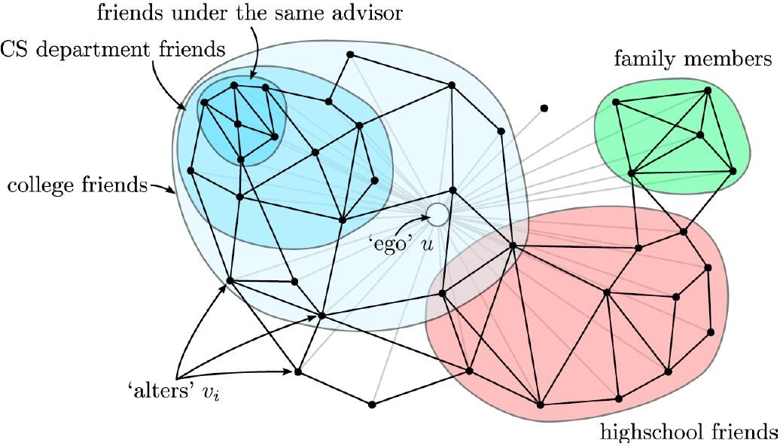
Graph Theory and its Applications Graphs as models
Community Detection

Slide 50

THANK YOU
Dr. Arti Arya
Department of Computer Science &Engineering
artiarya@pes.edu

